Slide 1
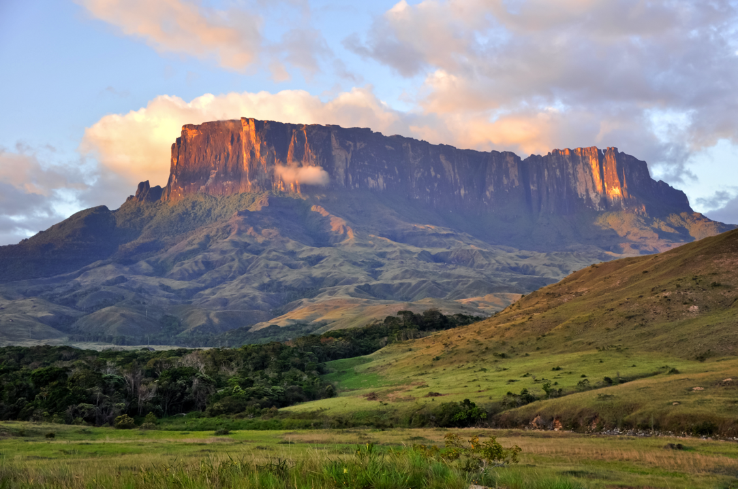
Landforms of Weathering & Erosion

Slide 2
Badlands
Extensive tracts of heavily eroded, uncultivable land with little vegetation.

Slide 3
Canyon
A deep gorge, typically one with a river flowing through it.

Slide 4
Cave
A large underground chamber, typically of natural origin, in a hillside or cliff.

Slide 5
Cliff
A steep rock face, especially at the edge of the sea.

Slide 6
Gully
A water-worn ravine.

Slide 7
Hogback
A long hill or mountain ridge with steep sides.

Slide 8
Lavaka
A hole inside a hill.

Slide 9
Mesa
An isolated flat-topped hill with steep sides, found in landscapes with horizontal strata.

Slide 10
Plain
A large area of flat land with few trees.

Slide 11
Rock Shelter
A cave opening at the bottom of a cliff.

Slide 12
Summit
The highest point of a hill or mountain.

Slide 13
Valley
A low area of land between hills or mountains, typically with a river or stream flowing through it.

Slide 14
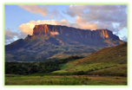
Credits
Paolo Costa Baldi
Ronadh
Wereldburger758
Richard Webb
Realbrvhrt
Daniel Mayer
Jojo
Guilhem Vellut
Graffity
Ballista
Le.Loup.Gris
J Brew
Clattuc~commonswiki

